Slide 1
Amphotericin B resistance in Leishmania: A polyomics approach

Slide 2


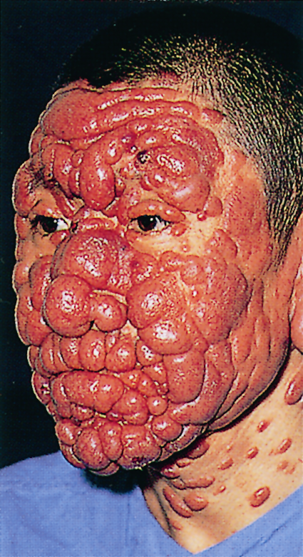
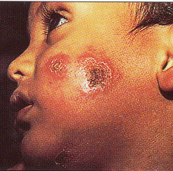
Leishmaniasis drug resistance
Around 2 million infected each year
Old and new world variants
Drugs exist, but new ones needed

Slide 3
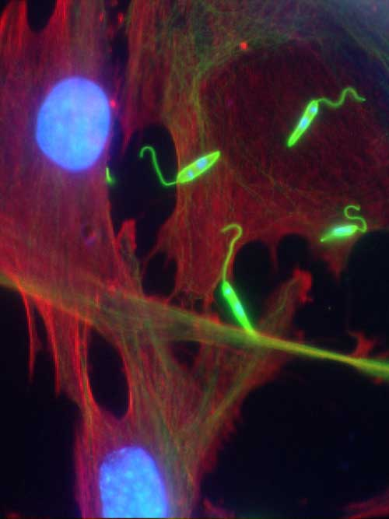

Slide 4
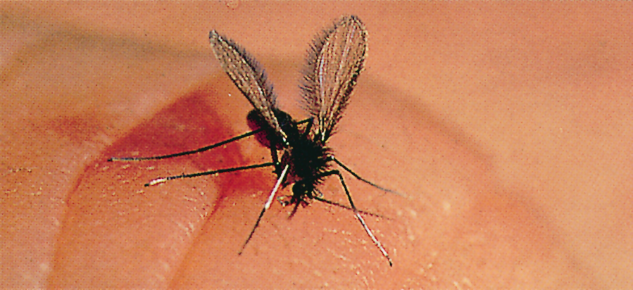
Leishmania parasites are transmitted by tiny bloodsucking sandflies

Slide 5
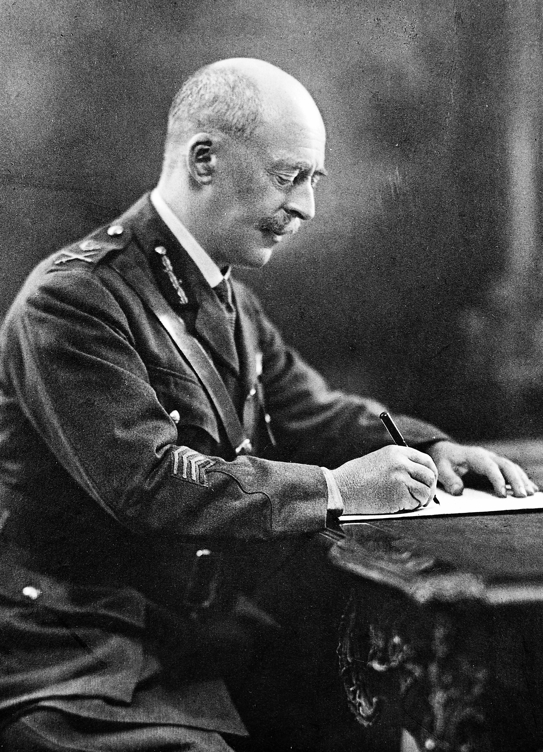

William Leishman, a Glasgow University medic, is credited with first having described Leishmania parasites in 1900

Slide 6
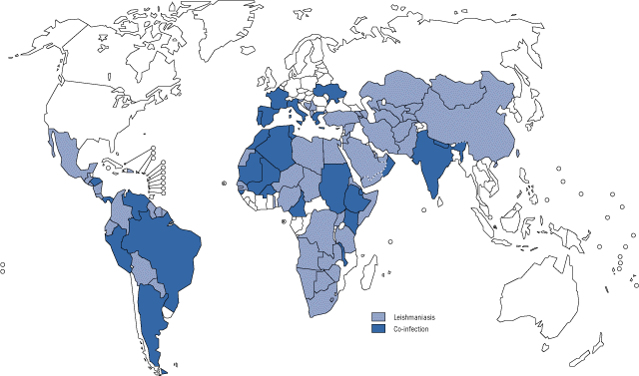
Leishmaniasis has emerged as an important opportunistic infection associated with AIDS in mediterranean states and also in other parts of the world.

Slide 7
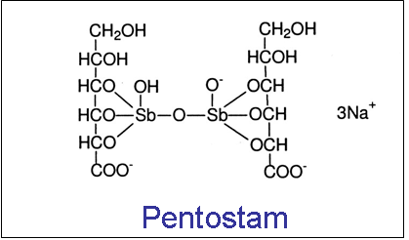
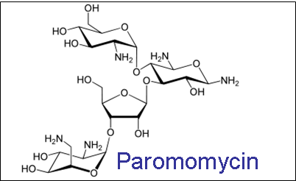
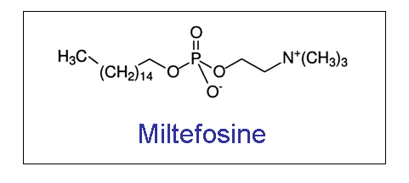
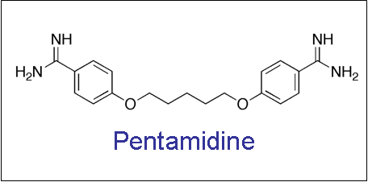
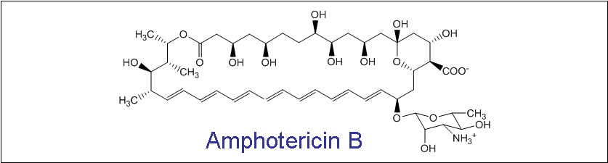
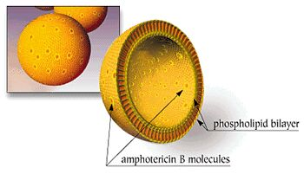

Slide 8
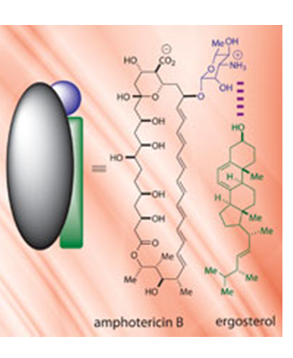
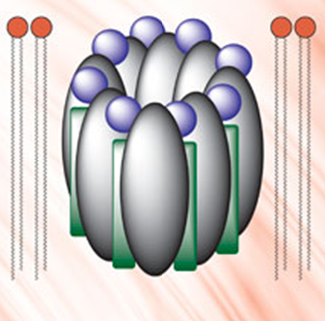

Slide 9

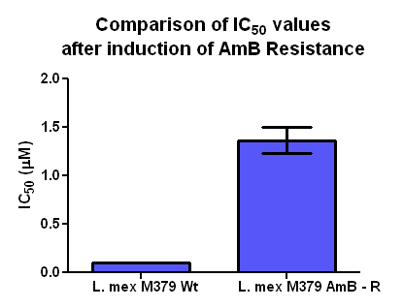
Aim: To understand AmB resistance in L. mex promastigotes using genomic DNA sequencing, Metabolomics and Proteomics (Polyomics)
AmB resistance selection
Resistance selected after ~16 passages (~2 months)
13-fold increase in IC₅₀ value

Slide 10
Comparative genomics

Slide 11
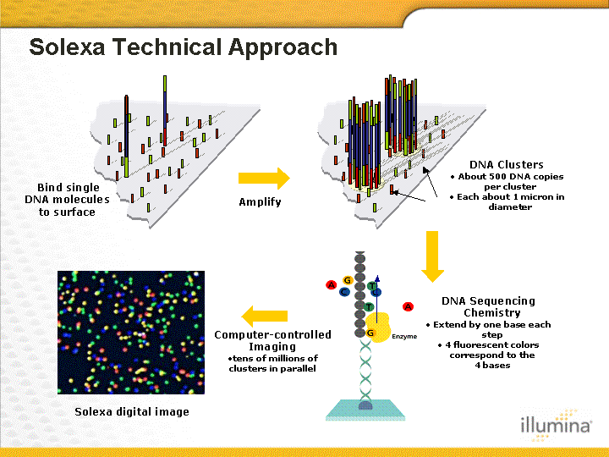
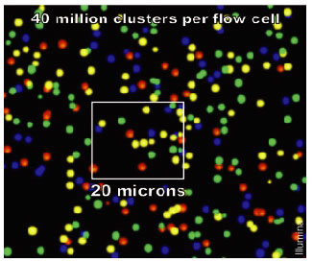
Illumina (Solexa) sequencing
Requires library preparation (DNA or RNA)
Paired end read technology
Short reads (< 300 bp)

Slide 12
“Resequencing”
Sequencing
Quality control
Alignment
Variant calling

Slide 13
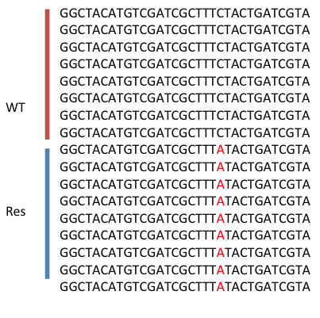
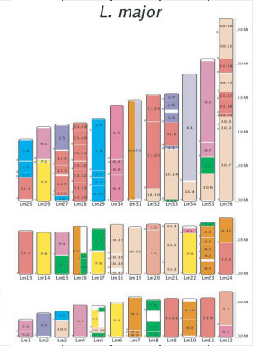
Single nucleotide polymorphisms (SNPs)
Insertion/Deletion mutations (InDels)
Larger structural variants
Whole genome sequence: 192 coding-sequence SNPs distinguish WT and resistant cells

Slide 14
Comparative metabolomics

Slide 15
Metabolomics comparison of L. mex. M379 and L. mex M379 AmB- R

Slide 16
Timetable
Mon 21 1100 Introduction
1145 NGS intro, tools, databases, QC and lining WT/Res to reference
Tues 22 1100 Alignment statistics, QC, Variant calling
Wed 23 1100 Variant filtration, Variant annotation, Visualizations in Genome browser (IGV)
Thur 24 1100 Proteomics data
Tues 29 1100 Metabolomics data
Wed 30 1100 Using metabolomics result to narrow down the loci
Thur31 1100 Protein structure
Fri 1 1100 Write up

Slide 17
Assessment:
Report in the style of a scientific paper containing:
Abstract
Introduction
Materials & methods
Results
Discussion
Any questions?

